Slide 1
MECH0064 Group Design Project A Compact Continuum Robotics Manipulator for Applications in Therapeutic Ultrasound
Department of Mechanical Engineering
Faculty of Engineering Sciences
Supervisor: Dr Reza Haqshenas
Group members: Zehao Ye, Yuehan Zhang, Jiachen Wu, Dawei Xu, Yuantong Li, Yuhao Zhu
Date: 15th March 2024

Slide 2
Content
Background (Yuantong)
Project Planning (Zehao)
Manipulator Design (Jiachen & Dawei)
Kinematics Simulation (Yuhao & Zehao)
Electronic Control (Yuantong & Yuehan)
GitHub Documentation (Zehao)

Slide 3
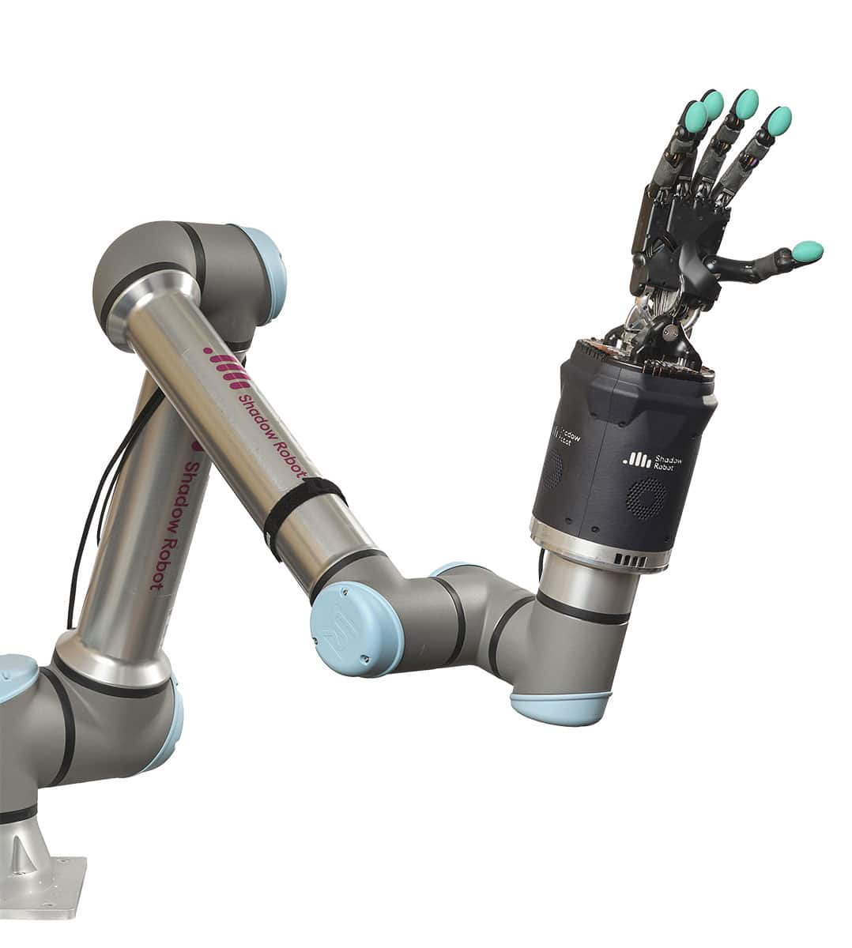
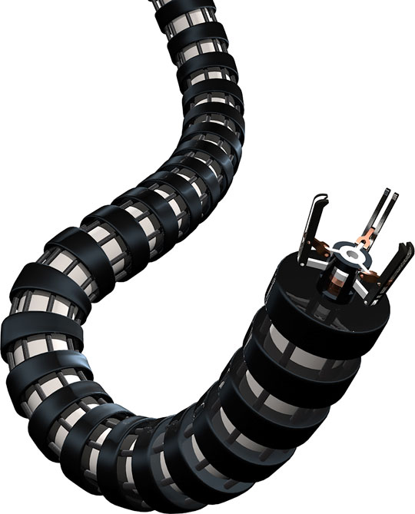
Background - Literature Review
Rigid-Joint Robots [1]
Continuum Robots [2]
[1] https://www.shadowrobot.com/news/how-does-a-robotic-manipulator-work/
[2] https://www.frontiersin.org/articles/10.3389/frobt.2020.630245/full

Slide 4
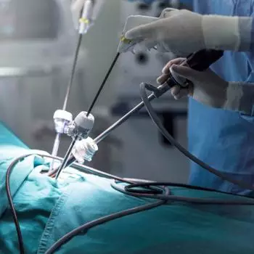
Background - Literature Review
Light-weight, flexible, adaptive to complex environments
Widely applied in:
- Surgical operations
- Search and rescue

Slide 5
Background - Objective
Develop a light-weight, fishbone-structured continuum robotic platform for precise manipulation of an ultrasonic transducer which can reach any point in a cubic working region of 300x300x300mm. The project starts on 16th October, 2023, and ends on 14th March, 2024.

Slide 6
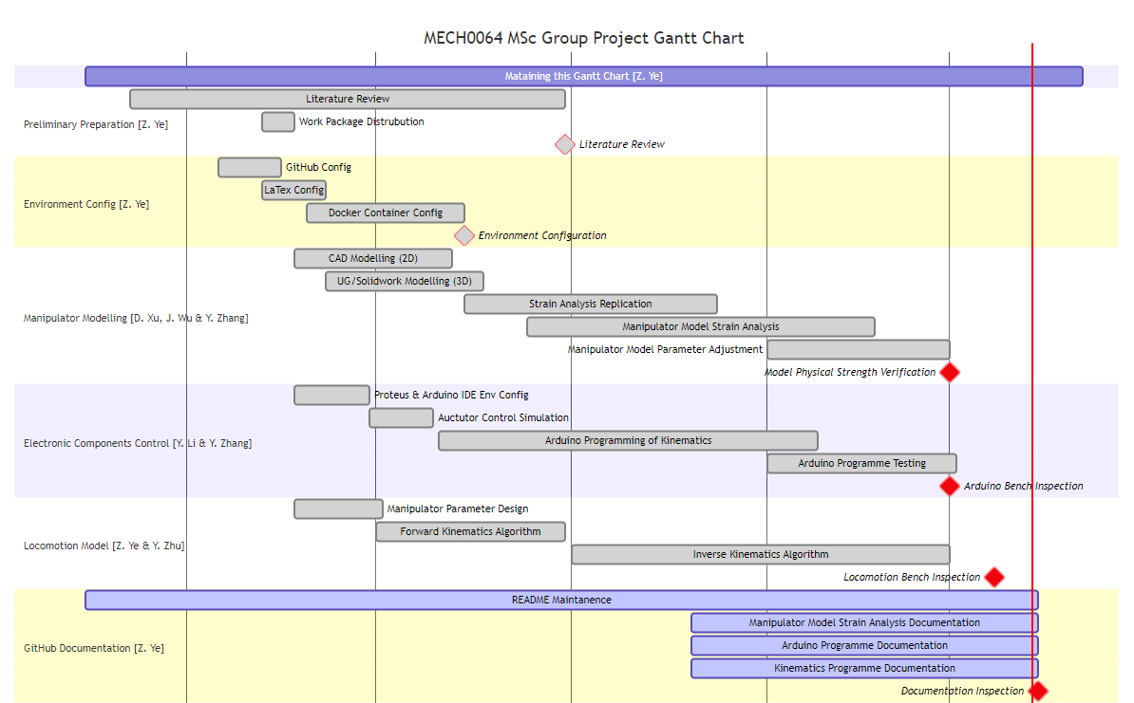
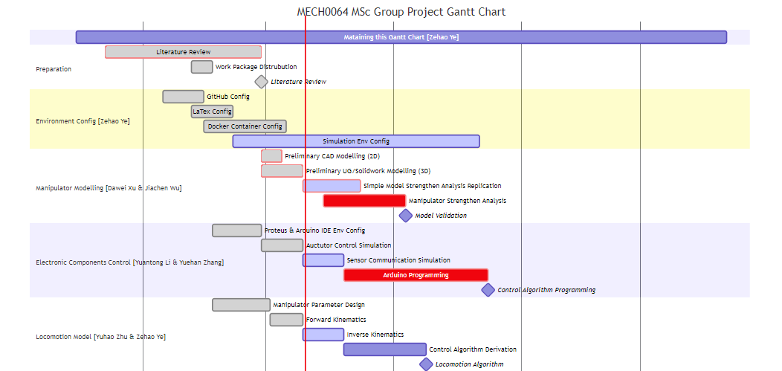
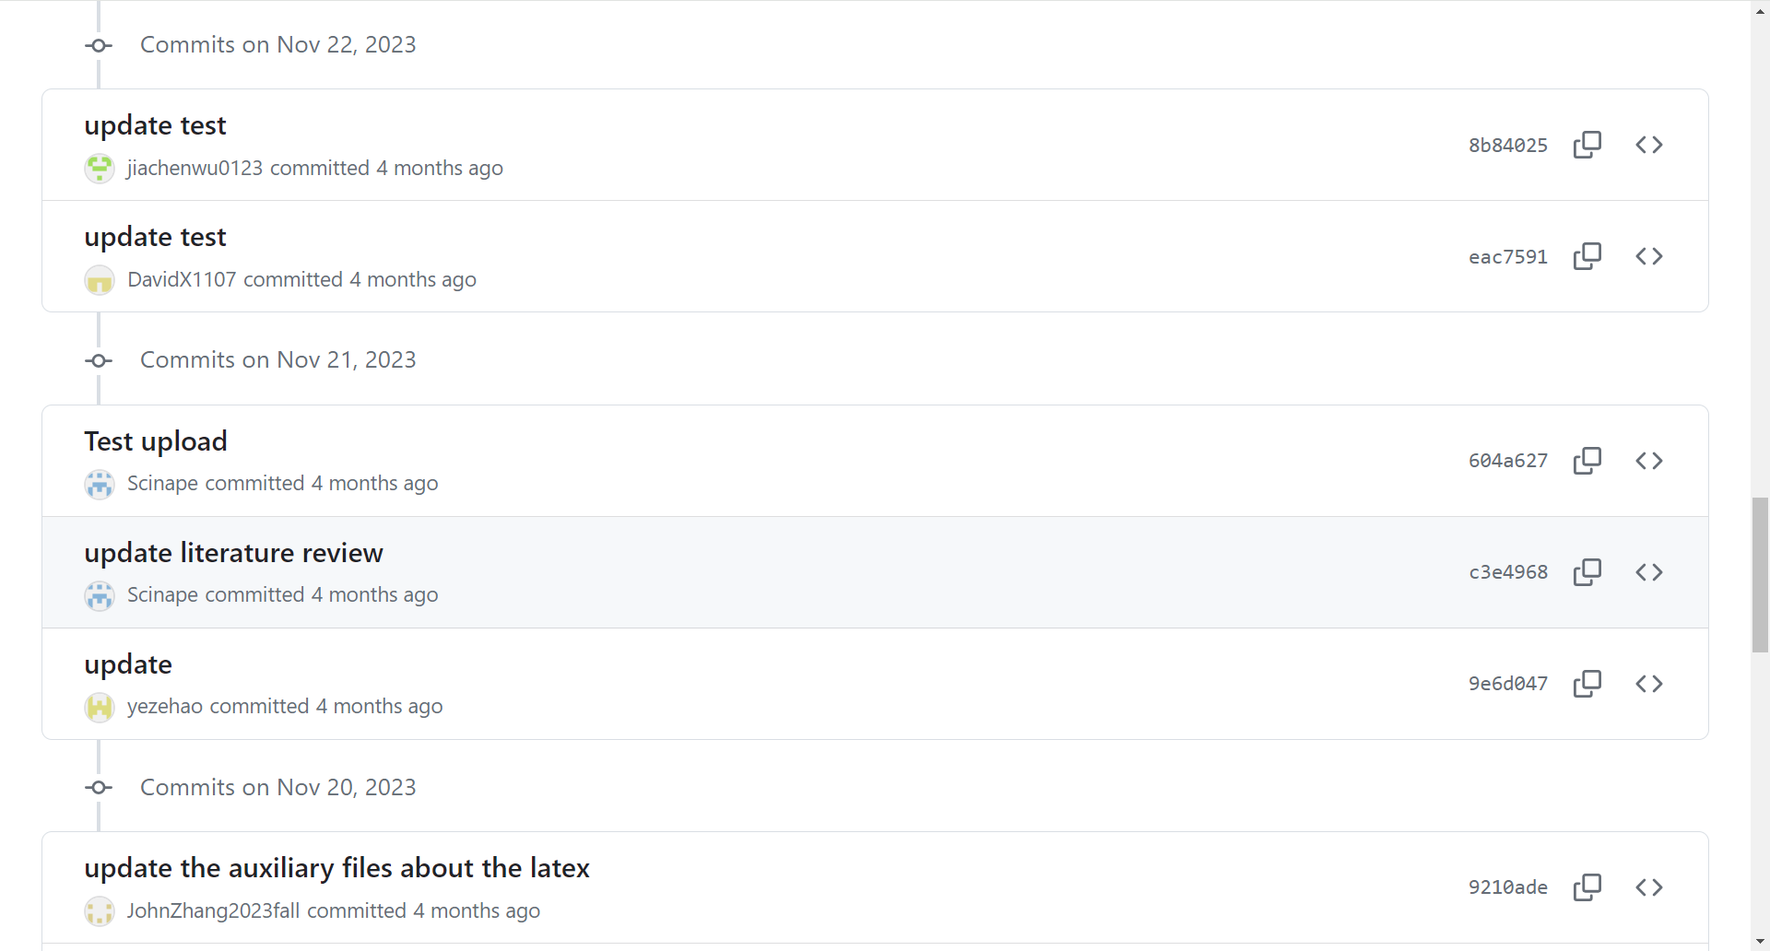
Project Planning
GitHub Workflow
Gantt Chart Updating
Previous Gantt Chart
Current Gantt Chart

Slide 7

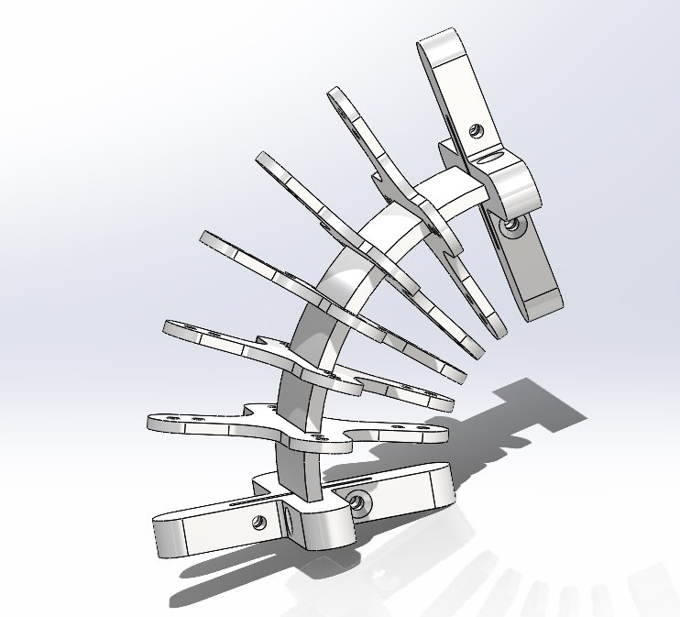
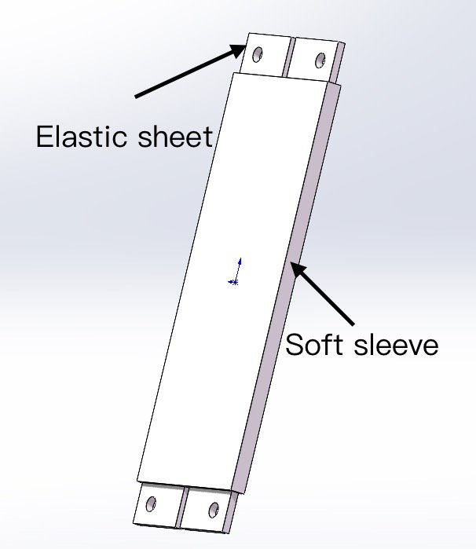
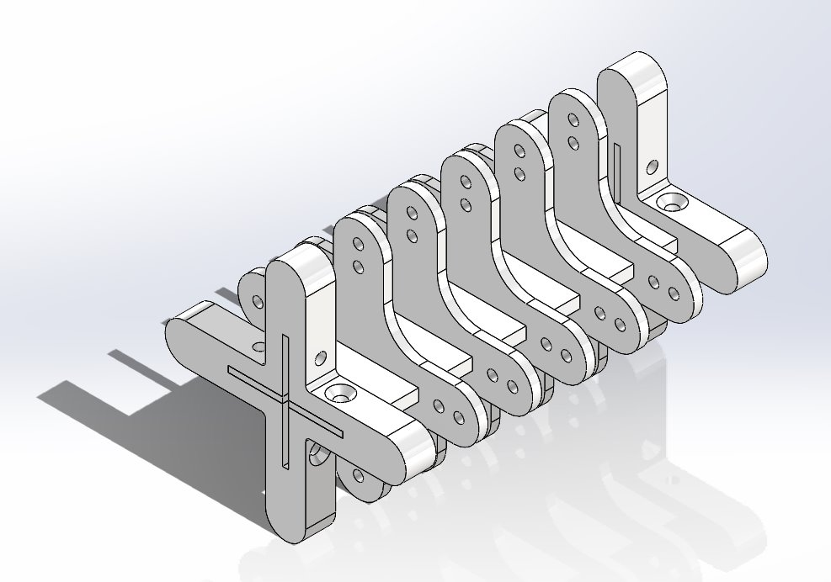
Structure
Parameters
Overall Length -------------------------- 675mm
Horizontal envelope Diameter -------- 40mm
Cross-shaped sheets Thickness -----1.5mm
Connector Thickness -------------------- 15mm
Elastic sheet Thickness ---------------- 0.2mm
Weight ----------------------------------------- 88g
Max. bending angle per Module --------- 73º
73º
Each Module
Notes:
Thanks for Zehao‘s introduction. My mission were the structural design and material selection of the manipulator, sizing it and drawing up the CAD model, and I considered the sustainability of the product, as well as assisting Dawei with some strength test works.
So, we designed this Bio- inspired continuum manipulator based on many previous studies.
The robot has an overall length of 675 mm, a horizontal envelope diameter of 40 mm and a weight of 88 grams.
Actually, the robot divided into 4 modules, and the overall structure is shown in the next slide.
These two pictures show the exact structure of one module. The maximum bending angle of each module is 73 degrees.
You can see that inside each module there are five cross-shaped sheets, which are connected by means of an interference fit with the soft sleeve wrapped around the elastic sheet.

Slide 8
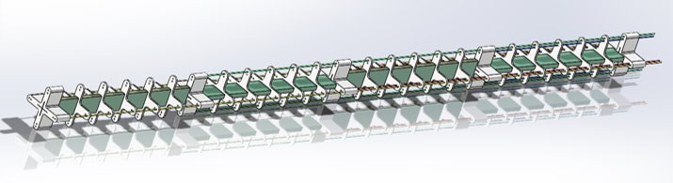
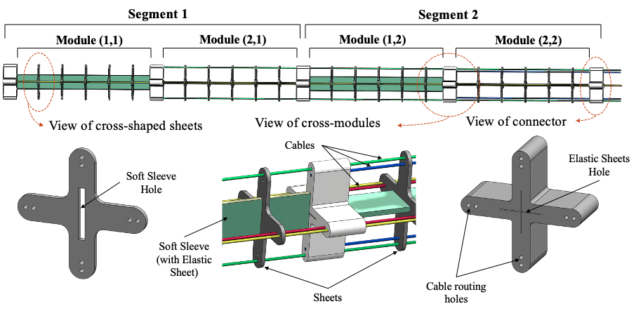
Overall connection
Notes:
the next slide shows the overall connection.
You can see The robot is divided into 2 segments. （A segment is formed by connecting one module with another module after 90 degrees of rotation through a connector. This is designed to allow the robot to move in all directions.）
We use motors to drive a pair of cables attached to each module to bend it.
There are totally four pairs of cables driving each module.

Slide 9
Material Selection
Cross-shaped sheets & Connectors --- Engineering plastics (ABS)
Elastic sheet ------------ 65Mn alloy steel (Young's modulus of 196.5 GPa)
Soft sleeve ----------------------------------------------------- Silicone rubber
Driving cables ------------------------------------------------------------- Nylon
3D Printing
Notes:
This slide shows the material selection.
Cross-shaped sheets and connectors are made of engineering plastics, a common material for 3D printing. The advantages are convenient manufacturing, light weight and less deformation.
The material of the pure soft sleeve is silicone rubber, which serves as a fixation.
A nylon cable drive mechanism has been integrated to mimic the complex musculature of fish, offering stability during deformation movements.
A critical aspect of our design was selecting the material for the elastic sheet. After thorough strength testing, Dawei and I opted for a 65 manganese alloy spring steel, characterized by a Young's modulus of 196.5 GPa, with a final thickness of 0.2 mm determined after extensive evaluation.
Here's Dawei to introduce the strength analysis section.

Slide 10
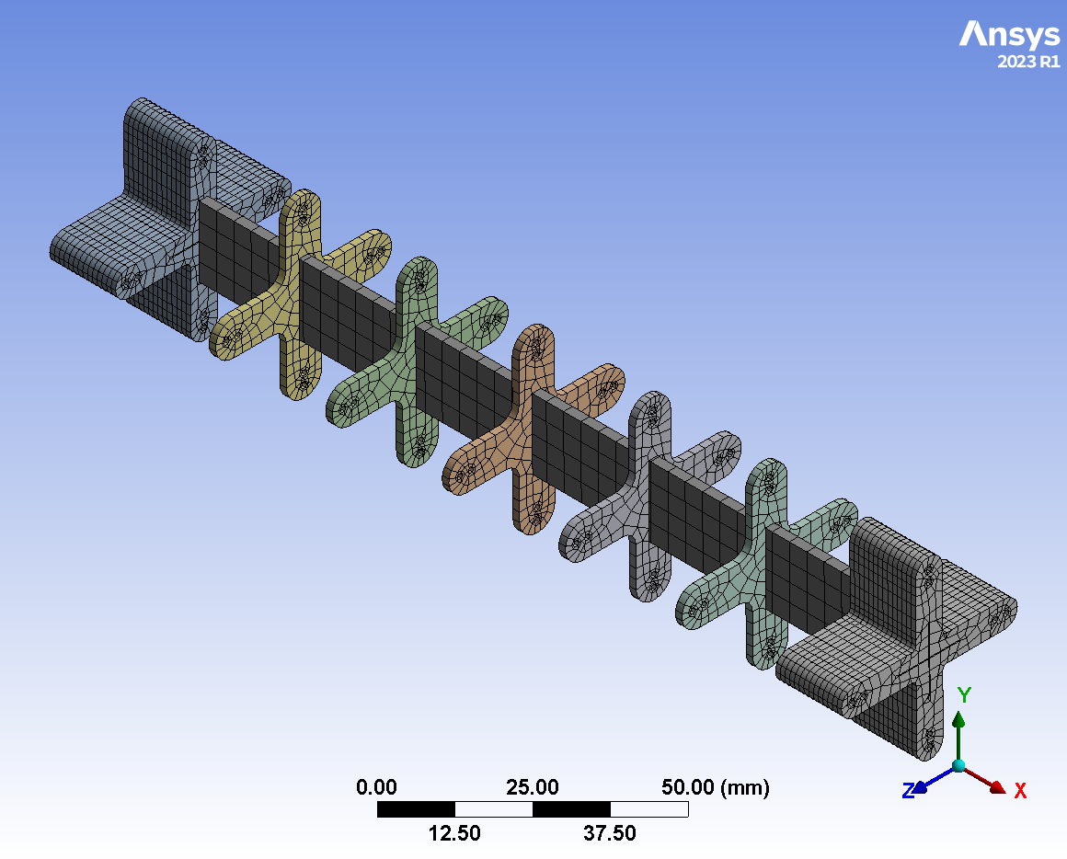
Strength Analysis
Model simplification:
Single module
Overlook the impact of cables
Meshing:
4 mm mesh size
Critical component - the elastic sheet

Slide 11
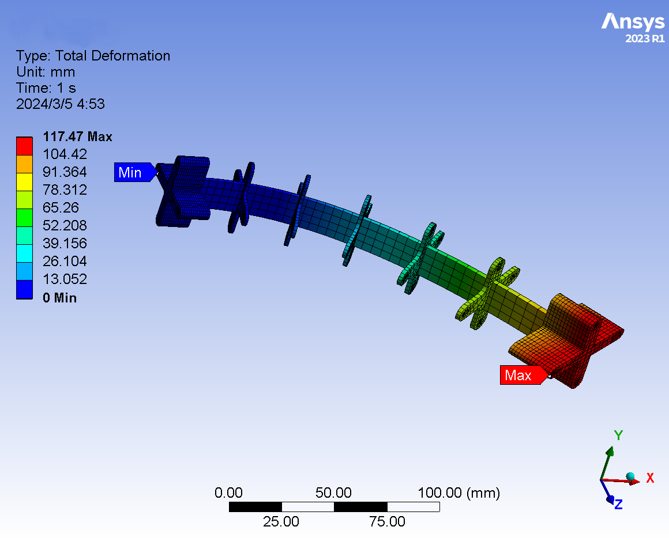
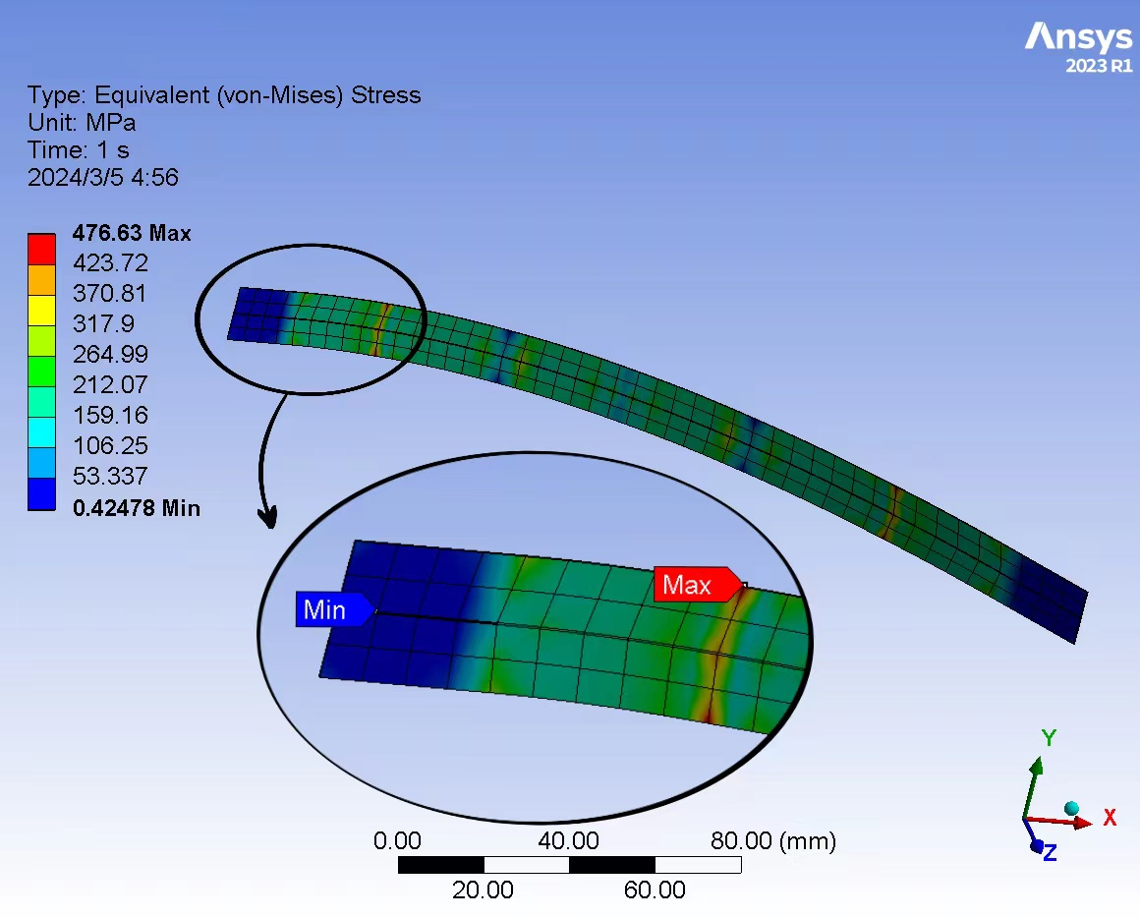
Strength Analysis
Displacement：
Max: 117.47 mm
Stress：
Max: 476.63 MPa (within the material's elastic limit)
Results indicate no risk of permanent deformation, ensuring the manipulator's reliability.

Slide 12
Strength Analysis
Limitations:
Overlooked critical interactions between modules.
Didn’t account for fatigue or long-term wear.
Didn’t consider the impact of cable.

Slide 13
Kinematics Simulation
Forward Kinematics Algorithm
Kinematics model & errors display
Workspace derivation
Programme Development
Inverse Kinematics Algorithm

Slide 14
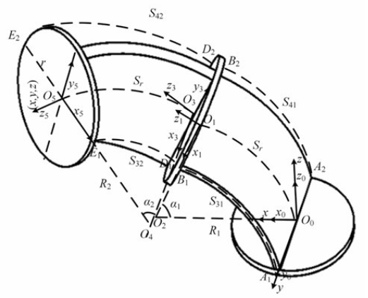
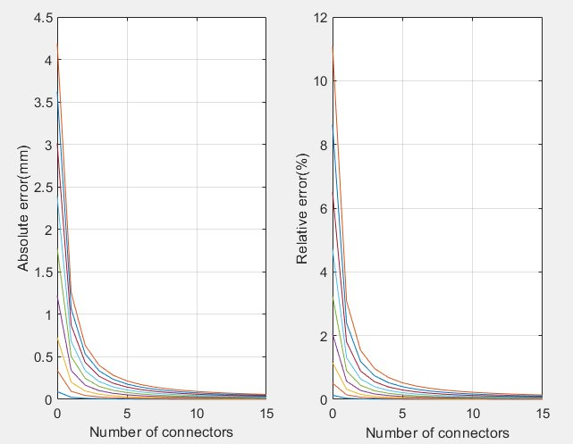
Kinematics Simulation
Forward Kinematics Model [3] & Errors Display
Both errors decreasing as the number of sheets increasing.
More sheets -> smaller workspace
[3] P. Zhou, J. Yao, S. Zhang, C. Wei, H. Zhang, and S. Qi, “A bioinspired fishbone continuum robot with rigid-flexible-soft coupling structure,” Bioinspiration & Biomimetics, vol. 17, no. 6, pp. 066012–066012, Oct. 2022, doi: https://doi.org/10.1088/1748-3190/ac8c10.
‌

Slide 15
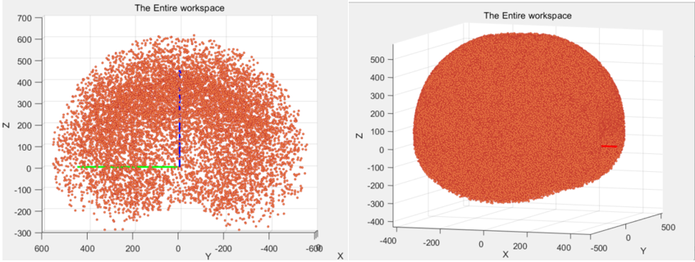
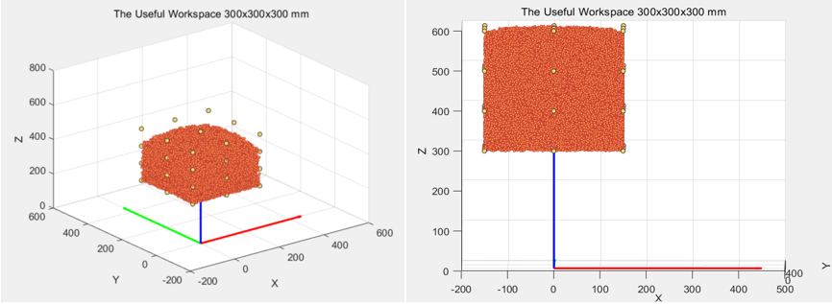
Kinematics Simulation
Workspace Derivation
ASD
The entire workspace with index=10000 and 1000000 respectively.
Greater index->More random floating points
Spherical shell-shape point cloud
300mm*300mm*300mm useful workspace
36 setting points on the surface and edge of cubic
H=350mm and 300mm respectively

Slide 16


Kinematics Simulation
Forward Kinematics
Programme Development
MATLAB for visualization
Python for parallel computing
Inverse Kinematics Algorithm
Algorithm Development
Trajectory Replication

Slide 17
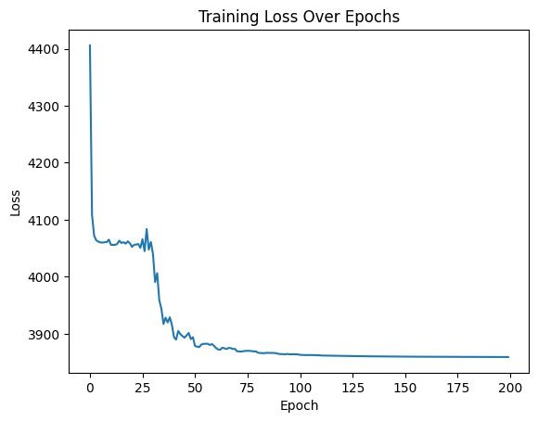
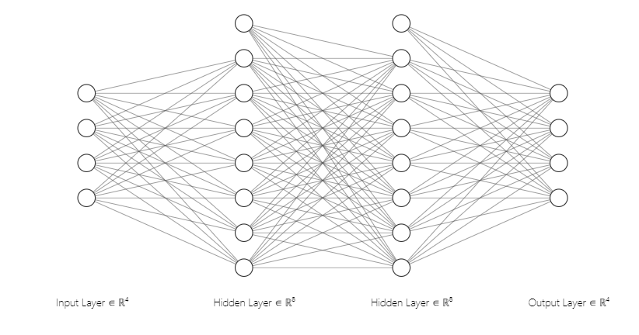
Kinematics Simulation
Inverse Kinematics Algorithm Development – Machine Learning
Artificial Neural Network (ANN)
Failed

Slide 18
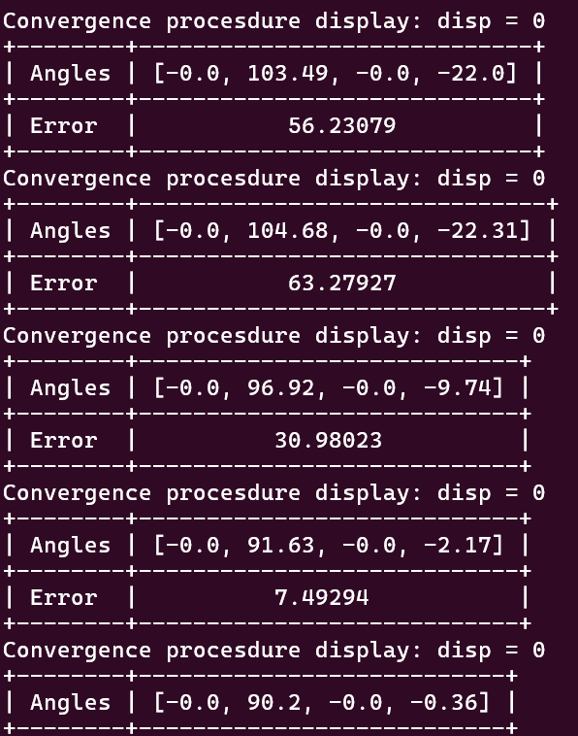
Kinematics Simulation
Inverse Kinematics Algorithm Development – FABRIKc [4]
An Iterative method
Example: target angles in degree
α = [0 90 0 0]
[4] W. Zhang, Z. Yang, T. Dong and K. Xu, "FABRIKc: an Efficient Iterative Inverse Kinematics Solver for Continuum Robots," 2018 IEEE/ASME International Conference on Advanced Intelligent Mechatronics (AIM), Auckland, New Zealand, 2018, pp. 346-352, doi: 10.1109/AIM.2018.8452693. keywords: {Kinematics;Jacobian matrices;Shape;End effectors;Robot kinematics;Service robots},
Successful

Slide 19
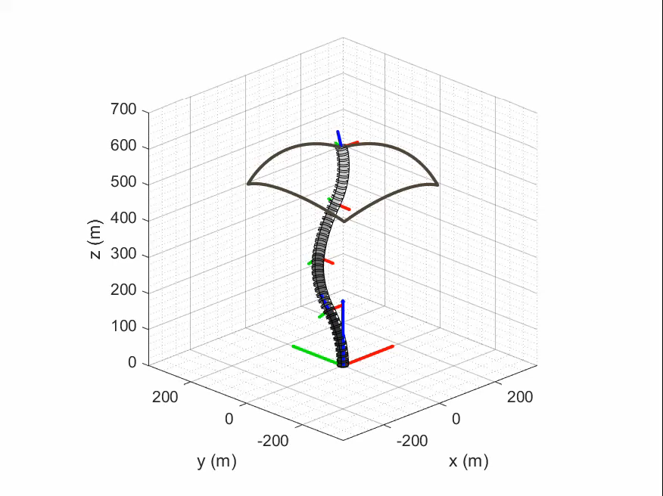
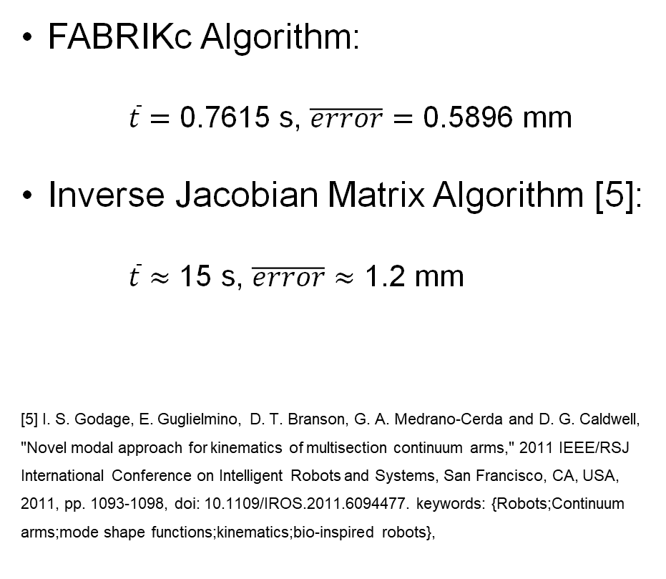
Kinematics Simulation
Trajectory Replication
FABRIKc Algorithm:
$\overline{t}=\text{0.7615} \text{s}$, $\overline{error}=\text{0.5896 }\text{mm}$
Inverse Jacobian Matrix Algorithm [5]:
$\overline{t}≈\text{15} \text{s}$, $\overline{error}≈\text{1.2 }\text{mm}$
[5] I. S. Godage, E. Guglielmino, D. T. Branson, G. A. Medrano-Cerda and D. G. Caldwell, "Novel modal approach for kinematics of multisection continuum arms," 2011 IEEE/RSJ International Conference on Intelligent Robots and Systems, San Francisco, CA, USA, 2011, pp. 1093-1098, doi: 10.1109/IROS.2011.6094477. keywords: {Robots;Continuum arms;mode shape functions;kinematics;bio-inspired robots},

Slide 20


Electronic Control
X
Arduino Mega 2560 & Stepper motors
Keyboard Input
MPU6050
OLED

Slide 21
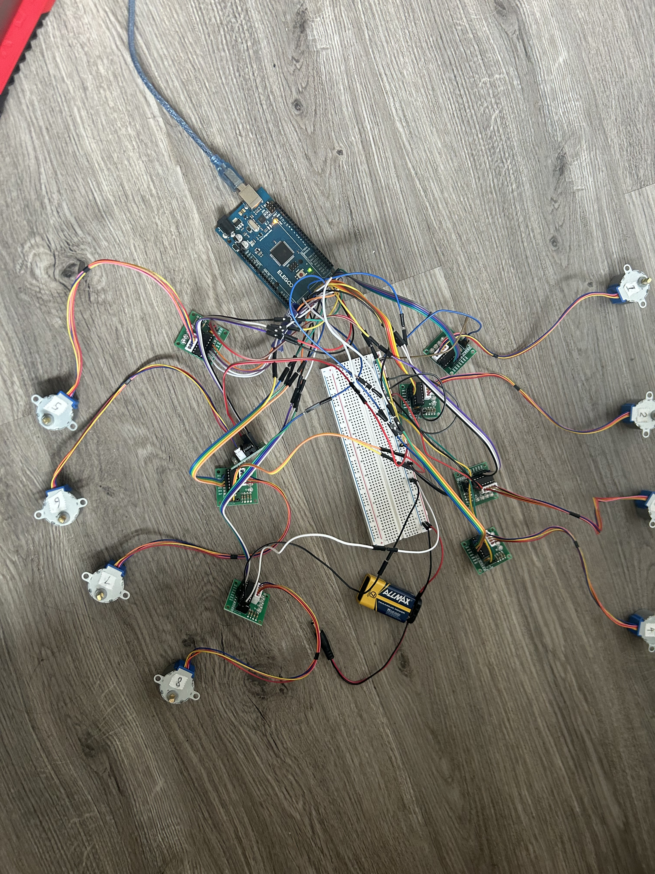
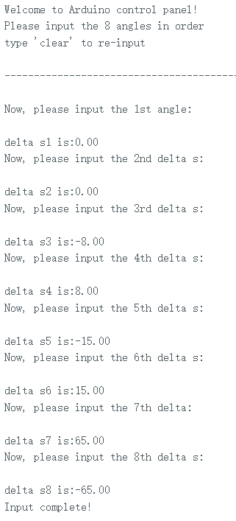
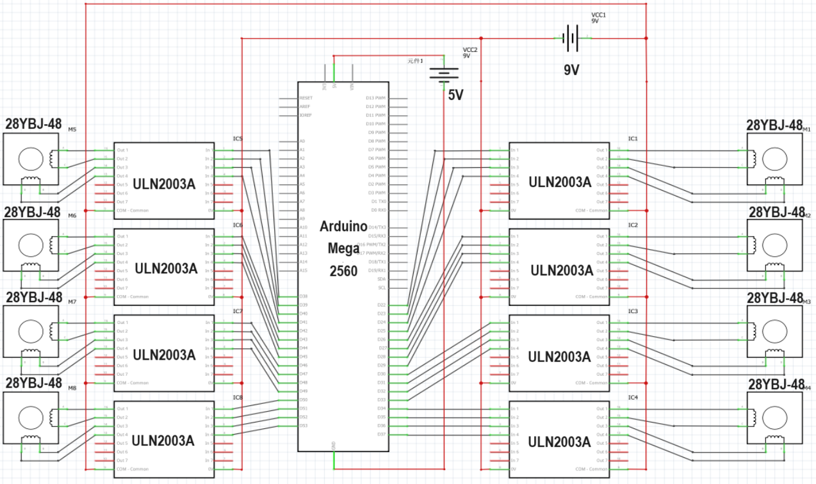
Electronic Components Control

Slide 22
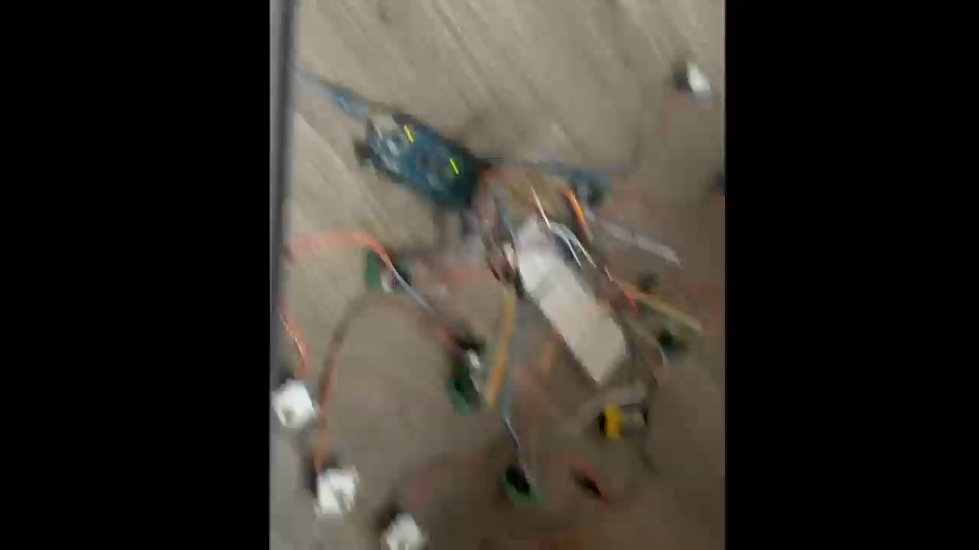

Slide 23
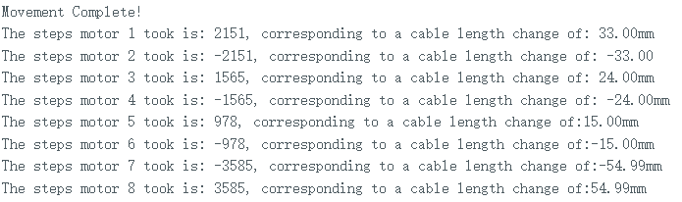
Electronic Control
stepper.currentposition()
stepper.distanctToEnd()

Slide 24
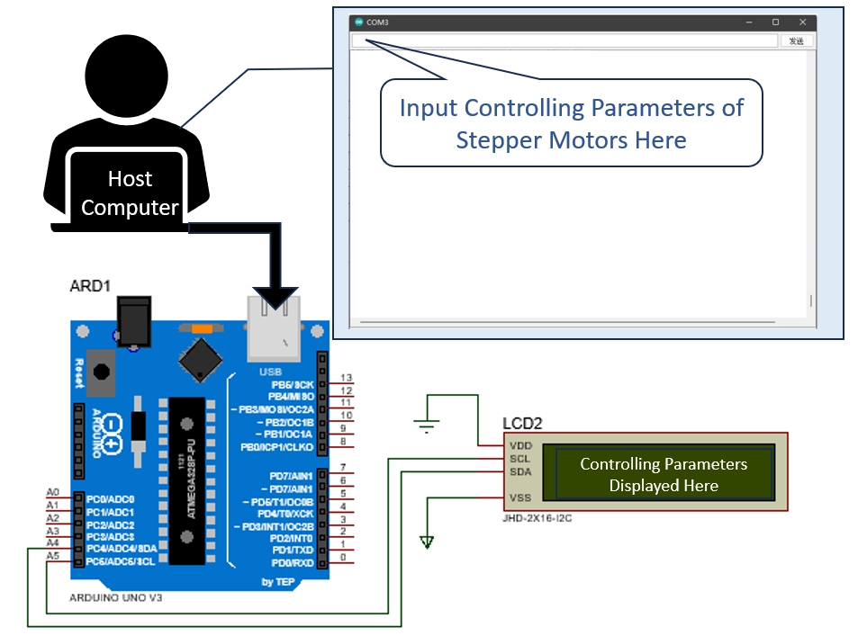
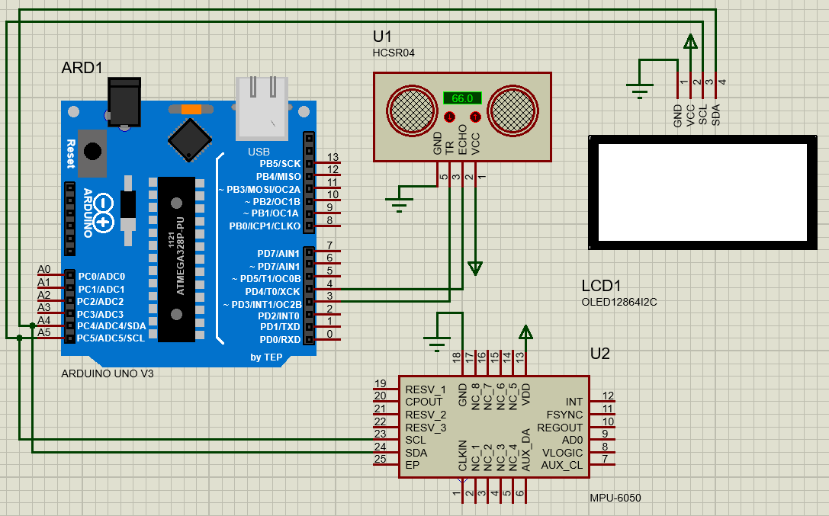
Data acquisition and display
LCD to Display Command
Controlled by Mega
Display parameters from host computer
OLED to Display Aquired Data
Controlled by UNO R3
Display data aquired from Tof & Gyro

Slide 25
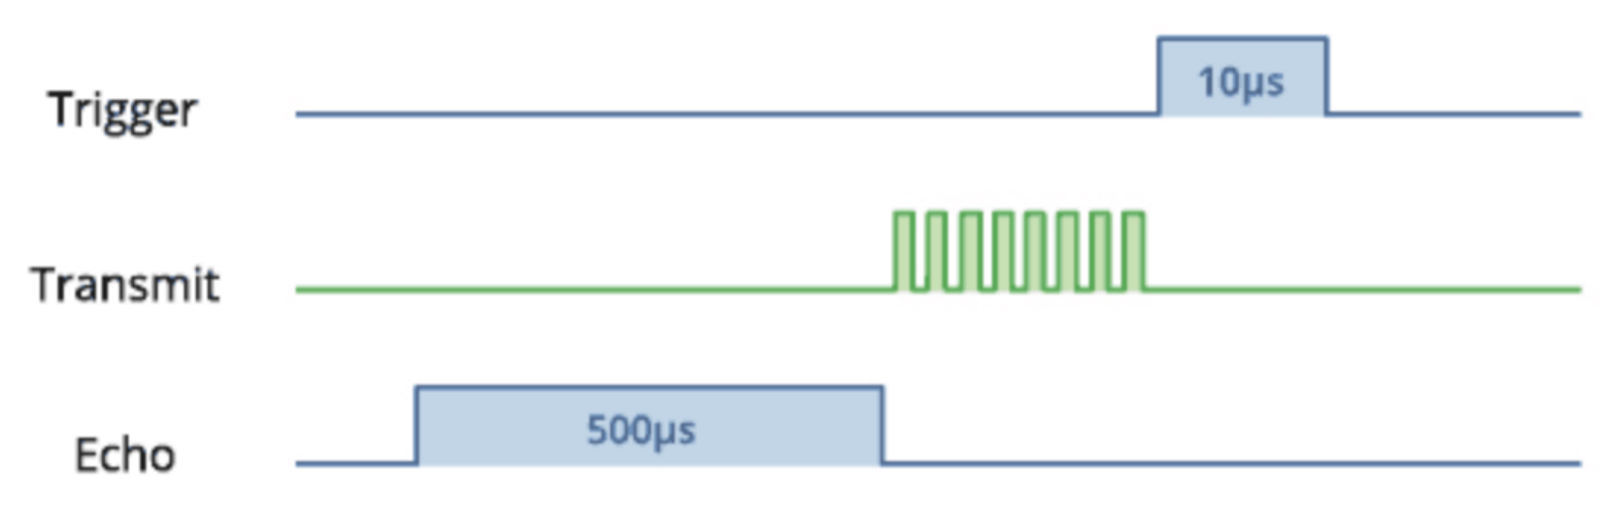
Data acquisition and display
Aquire distance by
Tof (Time of Flight)
HC-SR04
Range: 20 - 4,000 mm
Accuracy: 3mm
Basic Formula
Distance = (duration/2) × sound velocity
To get a clean High Trigger signal, a low level pulse should be sent previously

Slide 26
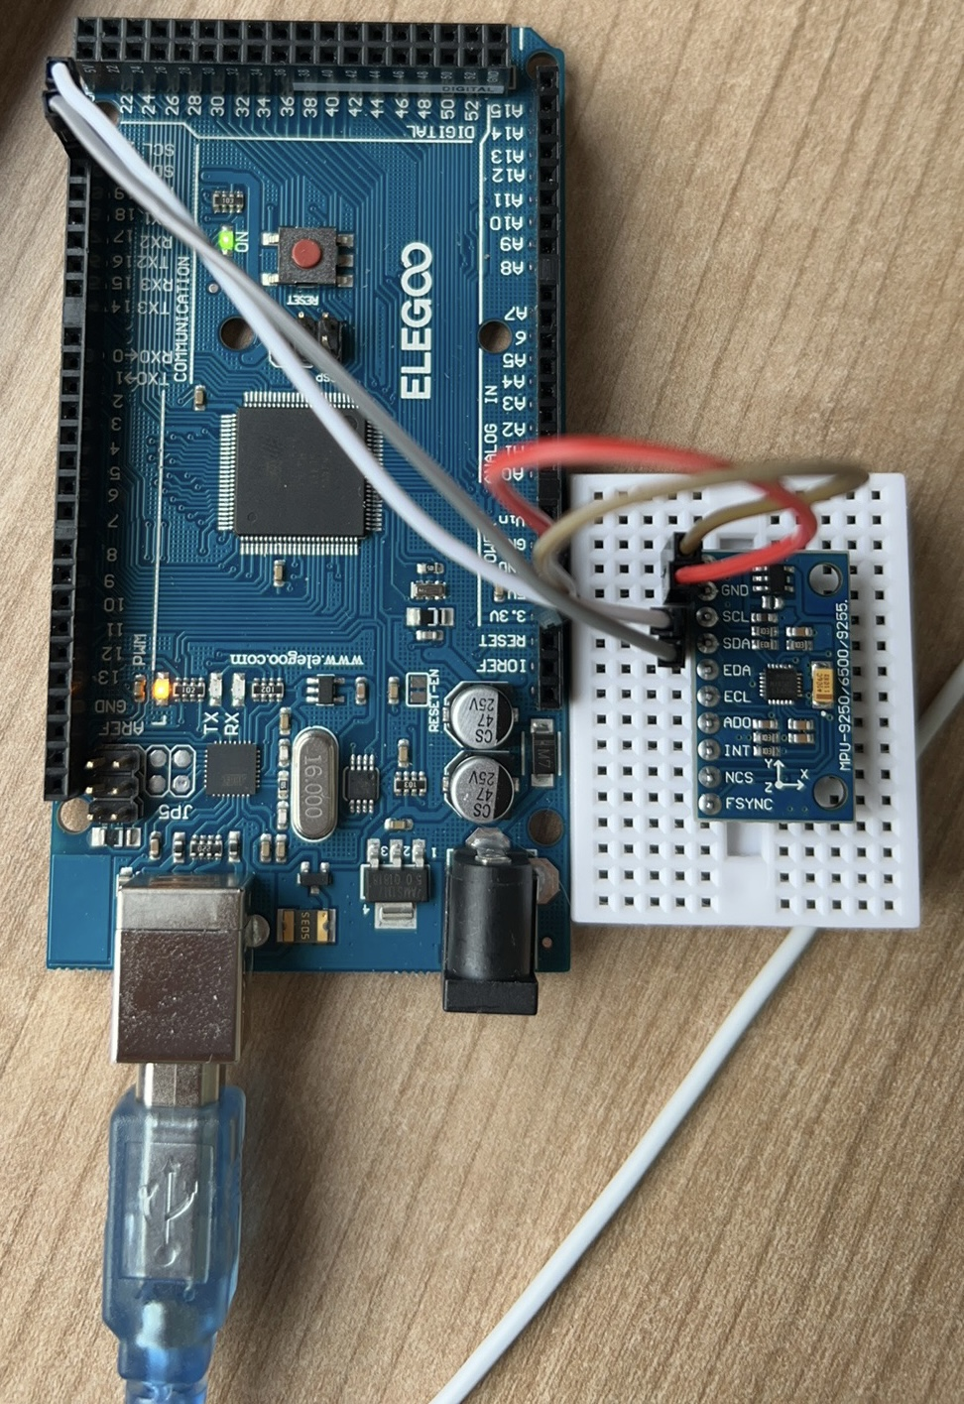
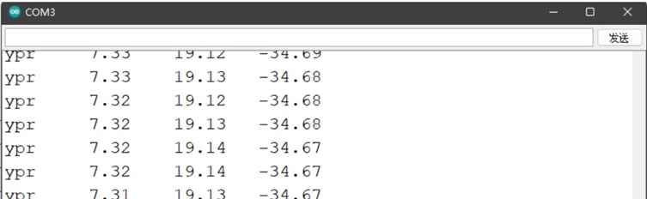
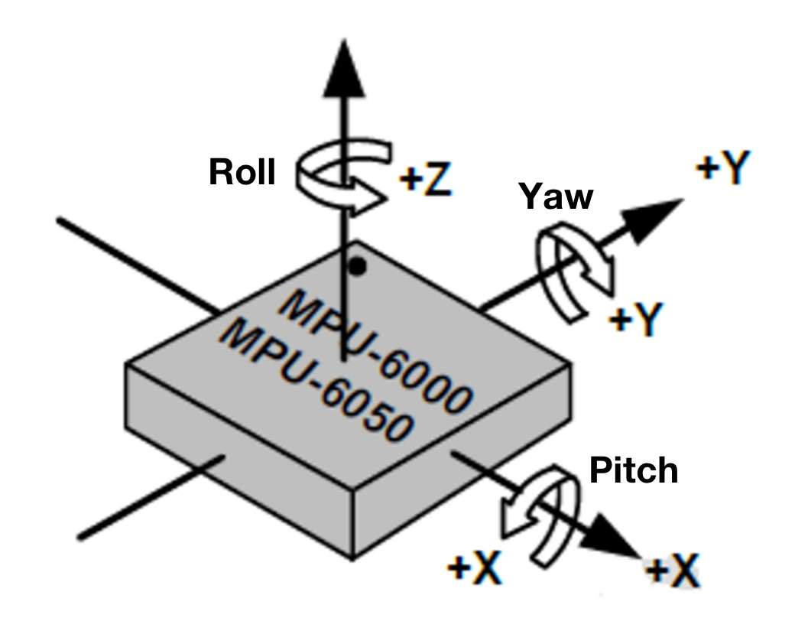
Data acquisition and display
Aquire orientation by Gyroscpe
MPU6050
Accuracy: 0.1°
Parameters displayed by serial monitor
problems about temperature-drift
Prolonged operation cause noise and drift issue, especially in Yaw direction.

Slide 27
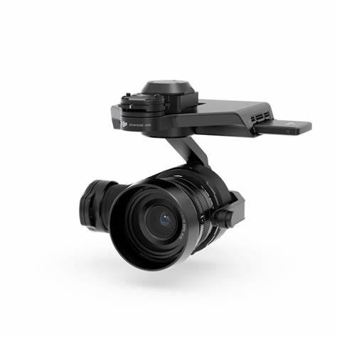
Data acquisition and display
axle 1
Limitations
Lack of spacial coordiate detection system
Incomplete feedback
Closed-loop control system is not constructed
Further improvements
Integration of ACCELERATION data from MPU6050 (low accuracy and impractical)
Use visualisation system (feasible but costy and complicated）
Use a gimble and Tof to measure the distance in 3 directions (feasible & simple)
axle 2

Slide 28
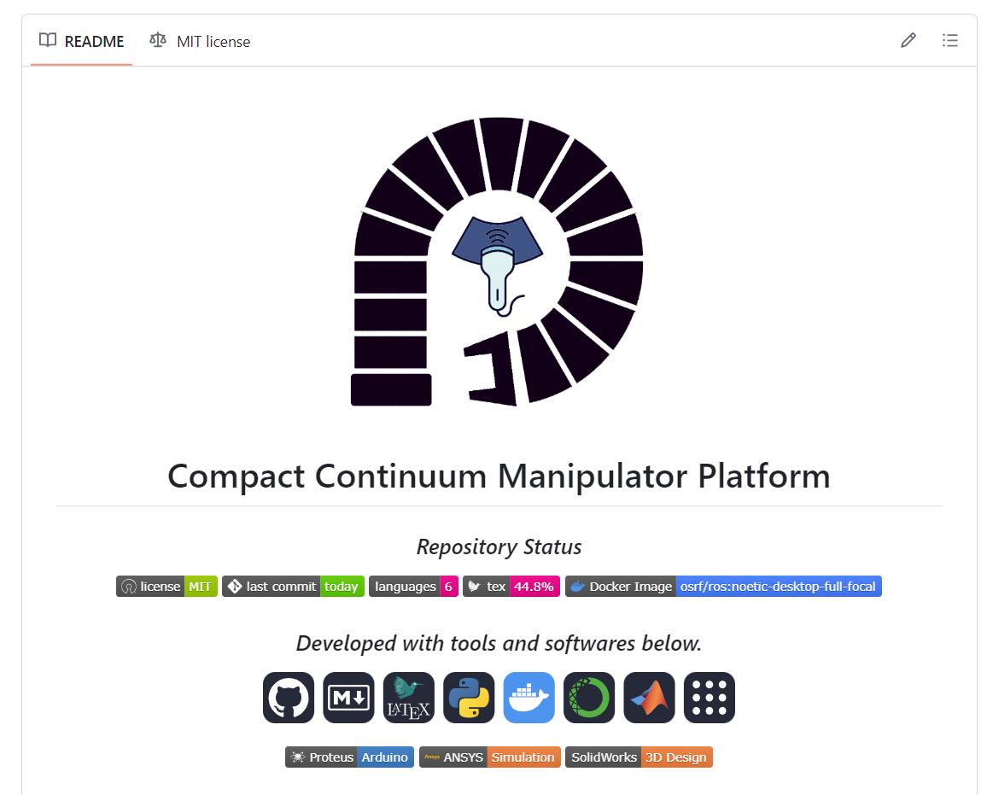
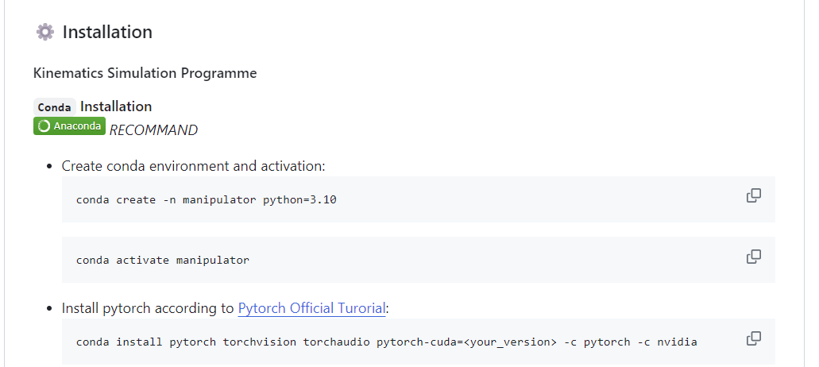

GitHub Documentation
Environment Configuration
Docker Image
README.md
Project Description
Running Tutorial

Slide 29

Learning More at Our GitHub Repository
SCAN QR Code

